Slide 1
Transportation Asset Management Competition – Group 25
Abdul Zakir Sayed (2145021)
Syed Sohaib Ali (2209809)
Mohammed Abdul Aziz (2215231)
Shaik Misbah Bilal (2145022)

Slide 2
Problem Statement:
To overcome challenges faced by agencies in the management of transportation systems due to the additional stressors originating from a changing climate.
2

Slide 3
Introduction:
This presentation focuses on our participation in the Transportation Asset Management (TAM) competition, where we employed machine learning techniques to develop predictive models for culvert ratings.
Transportation asset management plays a critical role in ensuring the safety, efficiency, and sustainability of transportation systems.
Culverts are vital components of transportation infrastructure, and accurate assessment and prediction of their condition and performance are essential for proactive maintenance planning and cost-effective asset management.
Our project aimed to evaluate the effectiveness of different machine learning algorithms in predicting culvert ratings based on various features and climate data.
The remainder of the presentation will be organized as follows: we will discuss data preprocessing, methodology, results, and conclusion
3

Slide 4
Objectives:
To determine the change in precipitation over the years and its affects on culverts.
To predict the culvert performance based on the culvert ratings using various machine learning models.

Slide 5





Workflow:
Data Processing
Data Preparation
Exploratory Data Analysis
Model Building
Model Deployment

Slide 6
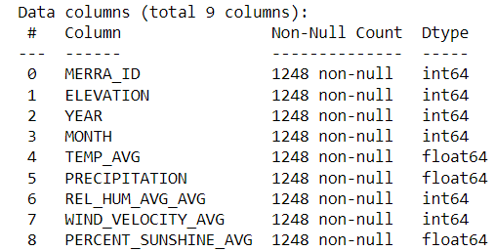
Dataset Background:
Merra Climate Dataset
Title | Total Rows | Total Columns
CDOT_Culvert Data | 5962 | 45
MerraClimate_Dat_Subset | 18,720 | 9
Merged_Data | 1248 | 9
Culvert Essential Repair | 739 | 17
Culverts Work Orders | 565 | 14

Slide 7
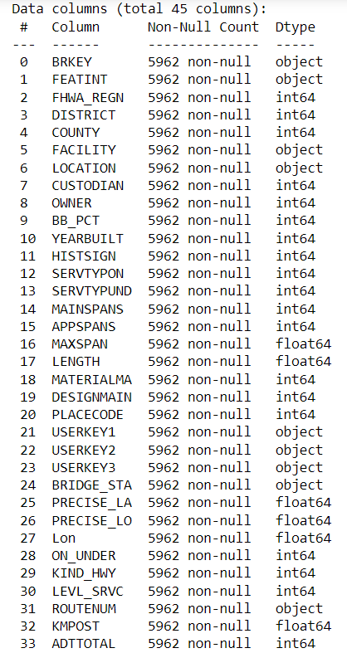
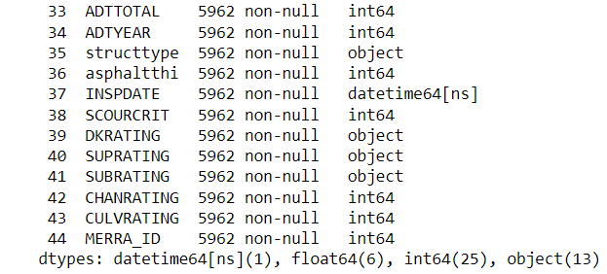
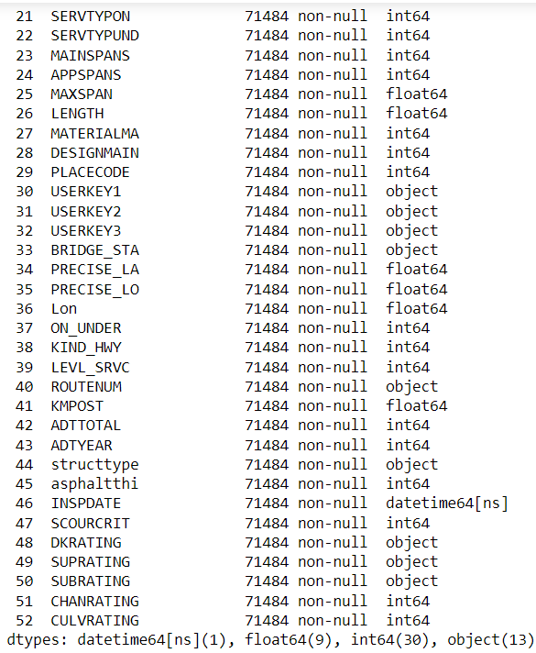
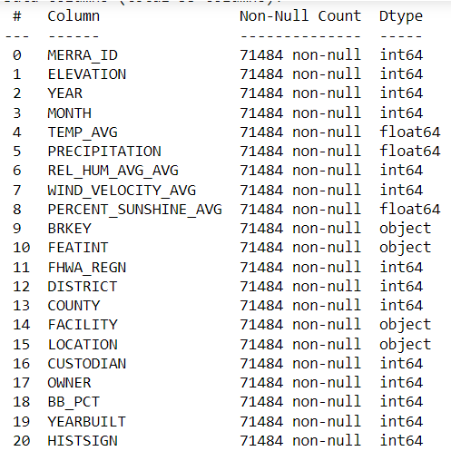
Culvert Dataset
Merged Dataset

Slide 8
Data Preprocesing:
The CDOT Culvert dataset contains information about culverts in Colorado, including their physical characteristics, location, and rating.
We performed data cleaning steps such as removing duplicates, handling missing values, and correcting data types to prepare the data for analysis.
We used the Pandas library in Python to load and manipulate the data. The pipeline included data cleaning, feature engineering, and merging of the datasets.
We created new features such as culvert age, culvert condition, and climate variables using the MerraClimate_Dat_Subset dataset to incorporate environmental factors into the predictive models.
We used the Pandas library in Python to load and manipulate the data. The pipeline included data cleaning, feature engineering, and merging of the datasets

Slide 9
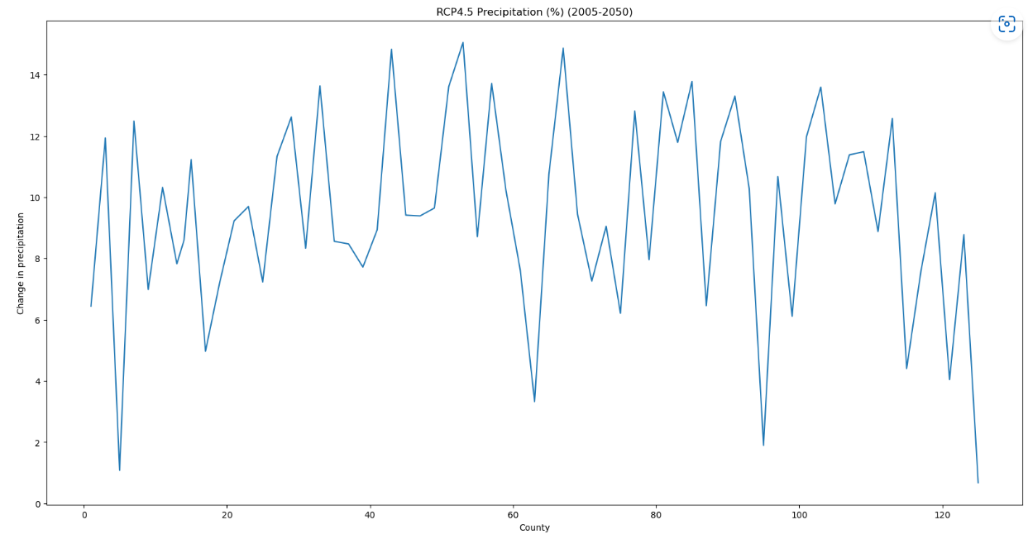
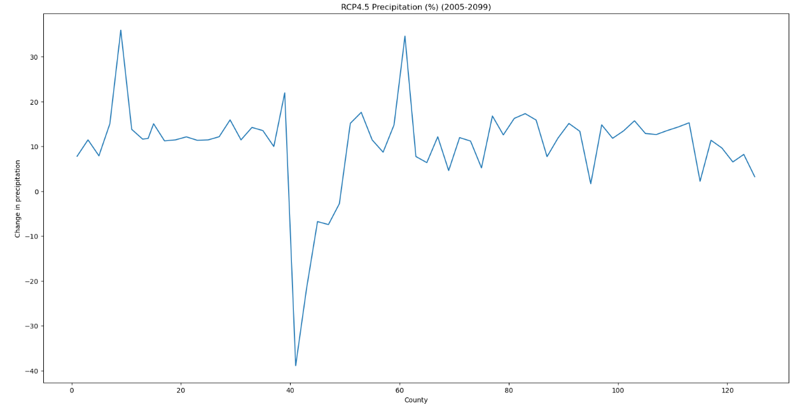
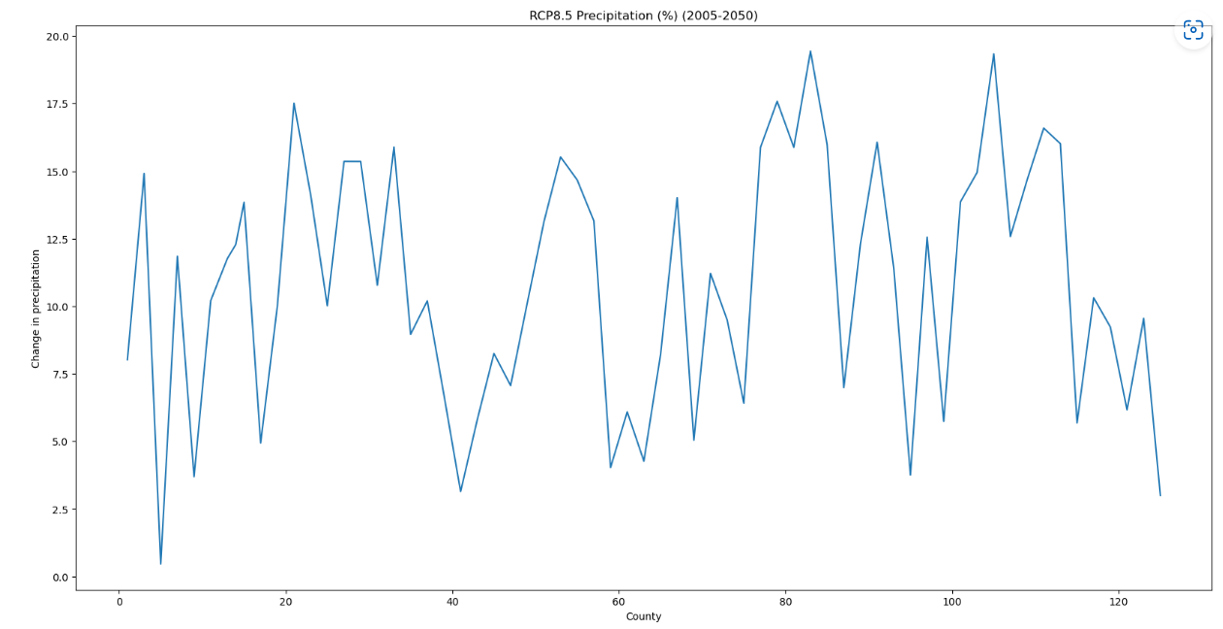
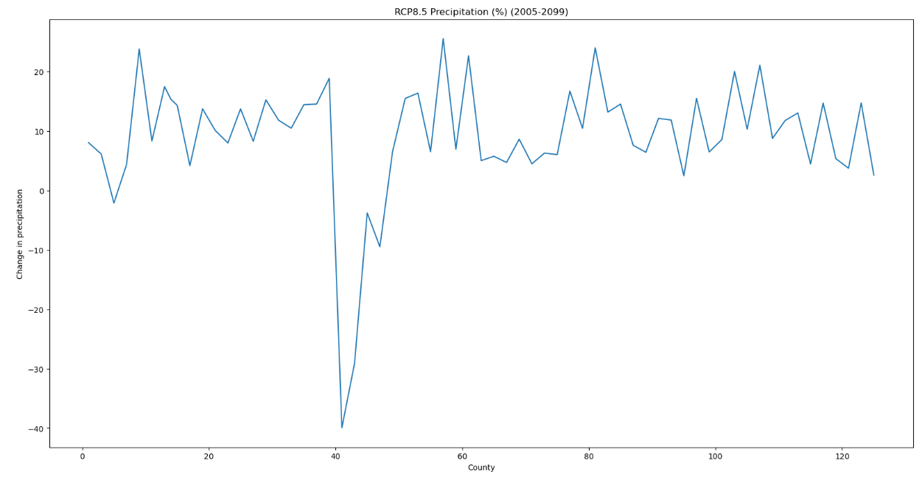
Data Visualization:

Slide 10
Model training and Evaluation:
We trained six different classifiers: Random Forest, CART (Decision Tree), Naive Bayes, KNN, Neural Networks, and Latent Dirichlet Allocation (LDA)
For each model, we split the data into training and testing sets.
evaluated various performance metrics, including accuracy, precision, recall, F1 score, specificity, negative predictive value, Matthews correlation coefficient, and geometric mean.
scikit-learn library in Python to implement the machine learning models.
The pipeline included loading the data using the Pandas library, data preprocessing including data cleaning.

Slide 11



Random Forest Regressor:
Initially, we extract the features that contribute to the merged data,
Then we standardize the data,
Now, build a random forest model using the function RandomForestRegressor( ) and fit it with 80% of the training data,
Now predicting the Significant culvert as follows :

Slide 12

Naive Bayes Regressor:
Initially, we extract the features that contribute to the merged data,
Then we standardize the data,
Now, build a naïve bayes model using the function GaussianNB( ) and fit it with 80% of the training data,
Now predicting the Significant culvert as follows :
12

Slide 13

KNN Classifier:
Initially, we extract the features that contribute to the merged data,
Then we standardize the data,
Now, build a knn model using the function KNeighborsClassifier( ) and select the nearest neighbors = 5,
Now predicting the Significant culvert as follows :
13
13

Slide 14

Classification and Regressor Tree:
Initially, we extract the features that contribute to the merged data,
Then we standardize the data,
Now, build a cart model using the function DecisionTreeClassifier( ) and fit it with 80% of the training data,
Now predicting the Significant culvert as follows :
14

Slide 15

Linear Discriminant Analysis:
Initially, we extract the features that contribute to the merged data,
Then we standardize the data,
Now, build a LDA model using the function LinearDiscriminantAnalysis ( ) and fit it with 80% of the training data,
Then we train the random forest classifier on the LDA-transformed data
Now predicting the Significant culvert as follows :

Slide 16

Neural Network MLPClassifier:
Initially, we extract the features that contribute to the merged data,
Then we standardize the data,
Now, build a Neural Network model using the function MLPClassifier( ) with 16 hidden layers and relu activation ,
Now predicting the Significant culvert as follows :
16
16

Slide 17
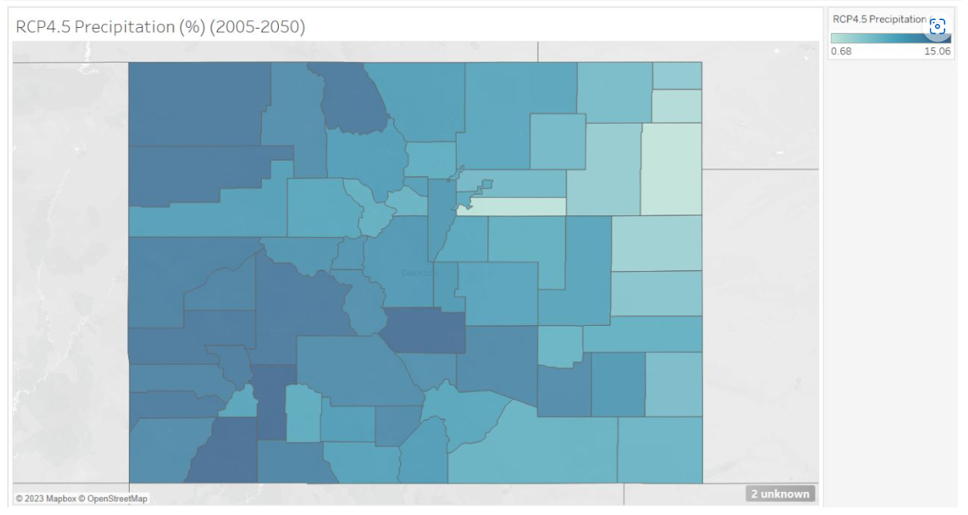
Results:
Changes in precipitation can have a significant impact on culverts and their performance.
RCP 4.5 and RCP 8.5 scenarios suggested potential changes in precipitation patterns that can impact culverts.
Local-scale assessments, incorporating specific regional characteristics and considering adaptation strategies, are essential for effectively addressing the impacts of climate change on culvert performance.
After the analysis we produced maps projecting percent change in precipitation in Colorado state.

Slide 18
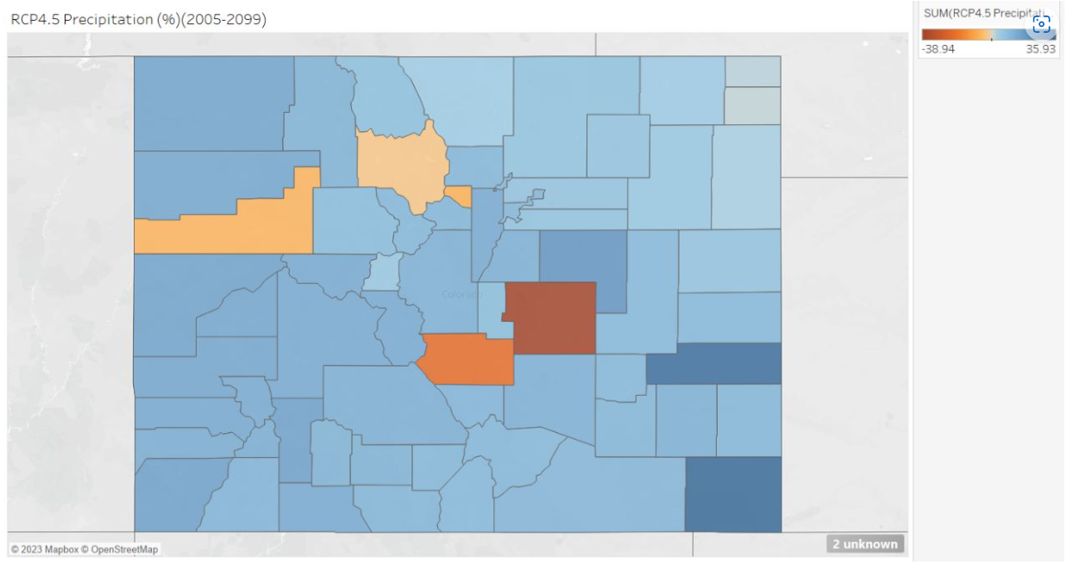
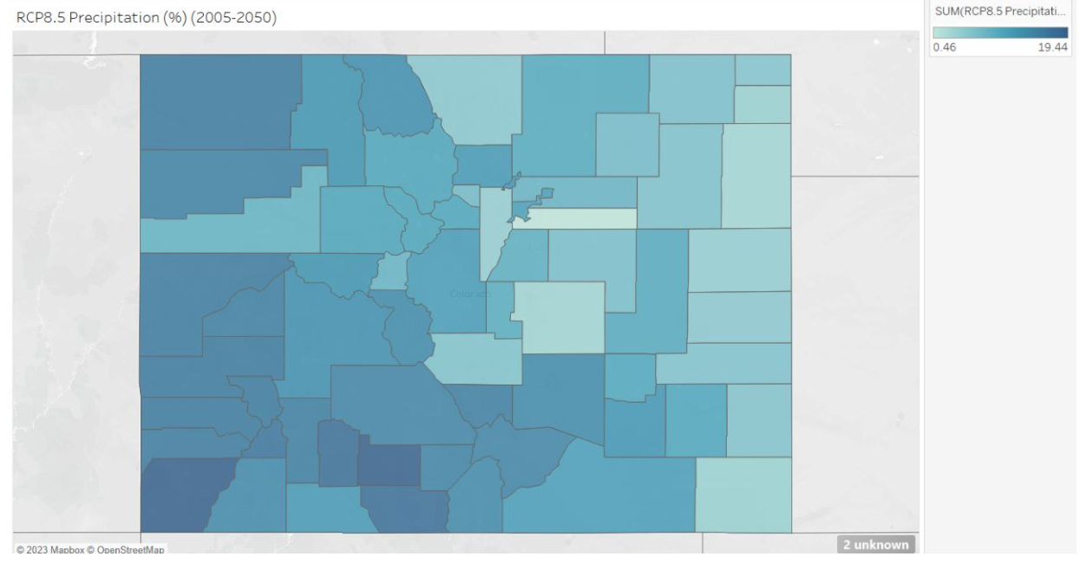

Slide 19
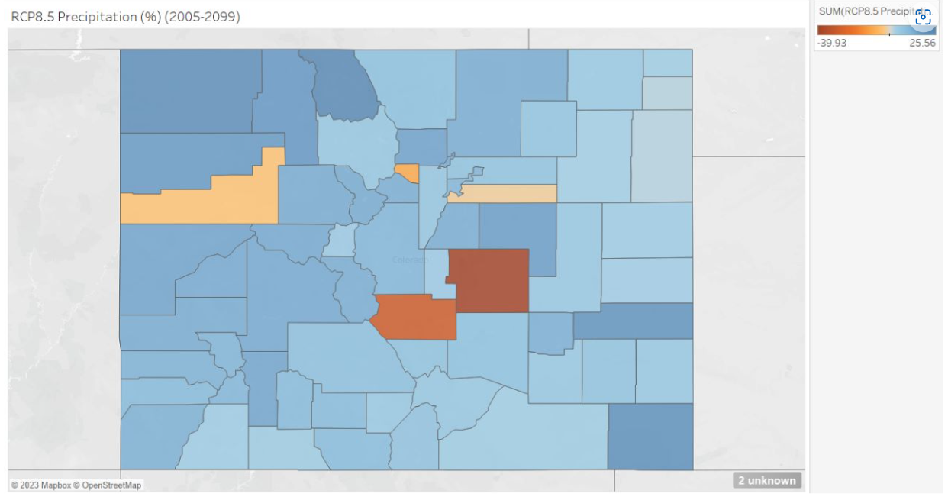

Slide 20
Model Comparison:
Models | Accuracy | F1 Score | Precision | Recall | Specificity | Mathew Coef. | Geometric Mean
Random Forest | 0.97 | 0.971 | 0.97 | 0.97 | 1 | 0.95 | 0.978
CART | 0.97 | 0.97 | 0.97 | 0.97 | 1 | 0.96 | 0.98
Naïve Bayes | 0.16 | 0.11 | 0.33 | 0.16 | 0.98 | 0.04 | 0.37
KNN | 0.55 | 0.55 | 0.55 | 0.55 | 1 | 0.34 | 0.65
Neural Network | 0.52 | 0.49 | 0.53 | 0.52 | 1 | 0.26 | 0.61
LDA | 0.66 | 0.66 | 0.67 | 0.66 | 1 | 0.50 | 0.73

Slide 21
Conclusion:
Changes in precipitation patterns can significantly impact culverts, leading to increased water flow, sediment transport, scouring, and undermining. An analysis of RCP 4.5 and RCP 8.5 scenarios projected potential changes in precipitation in Colorado
Some counties may experience increased rainfall, while others may face a decline. To protect culverts from these impacts, regular maintenance, upsizing and redesign, improved drainage systems, erosion control measures, and climate-resilient design are crucial.
The Random Forest Classifier and Classification And Regression Trees (CART) models demonstrated excellent performance, achieving high accuracy, precision, recall, and F1 scores across multiple classes, for the Predicting culvert ratings to determine performance and maintenance needs
Further experimentation and optimization can be conducted to enhance the performance of these models and ensure their suitability for practical implementation in determining culvert performance and maintenance needs.
21

Slide 22
Thank You

